Slide 1
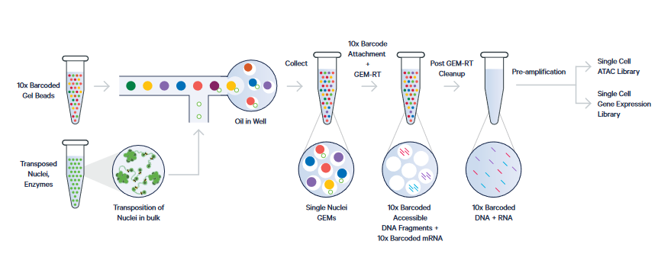
https://pages.10xgenomics.com/rs/446-PBO-704/images/10x_LIT099_Product-Sheet_Chromium-Single-Cell-Multiome-ATAC-Gene-Expression_Letter_digital.pdf

Slide 2
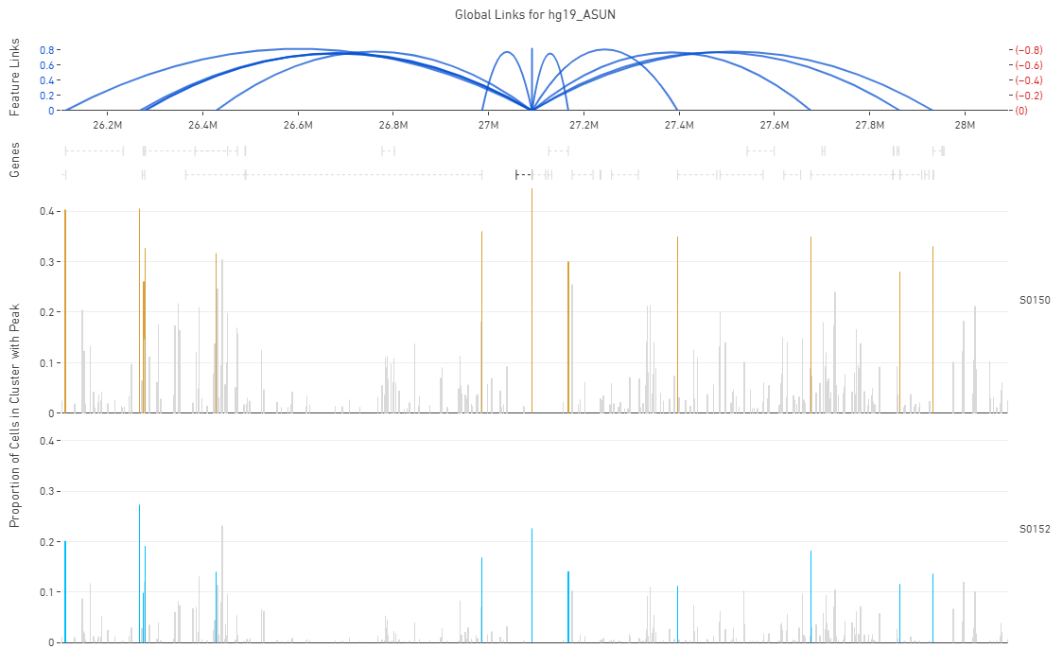
Output from 10x Loupe Browser

Slide 3
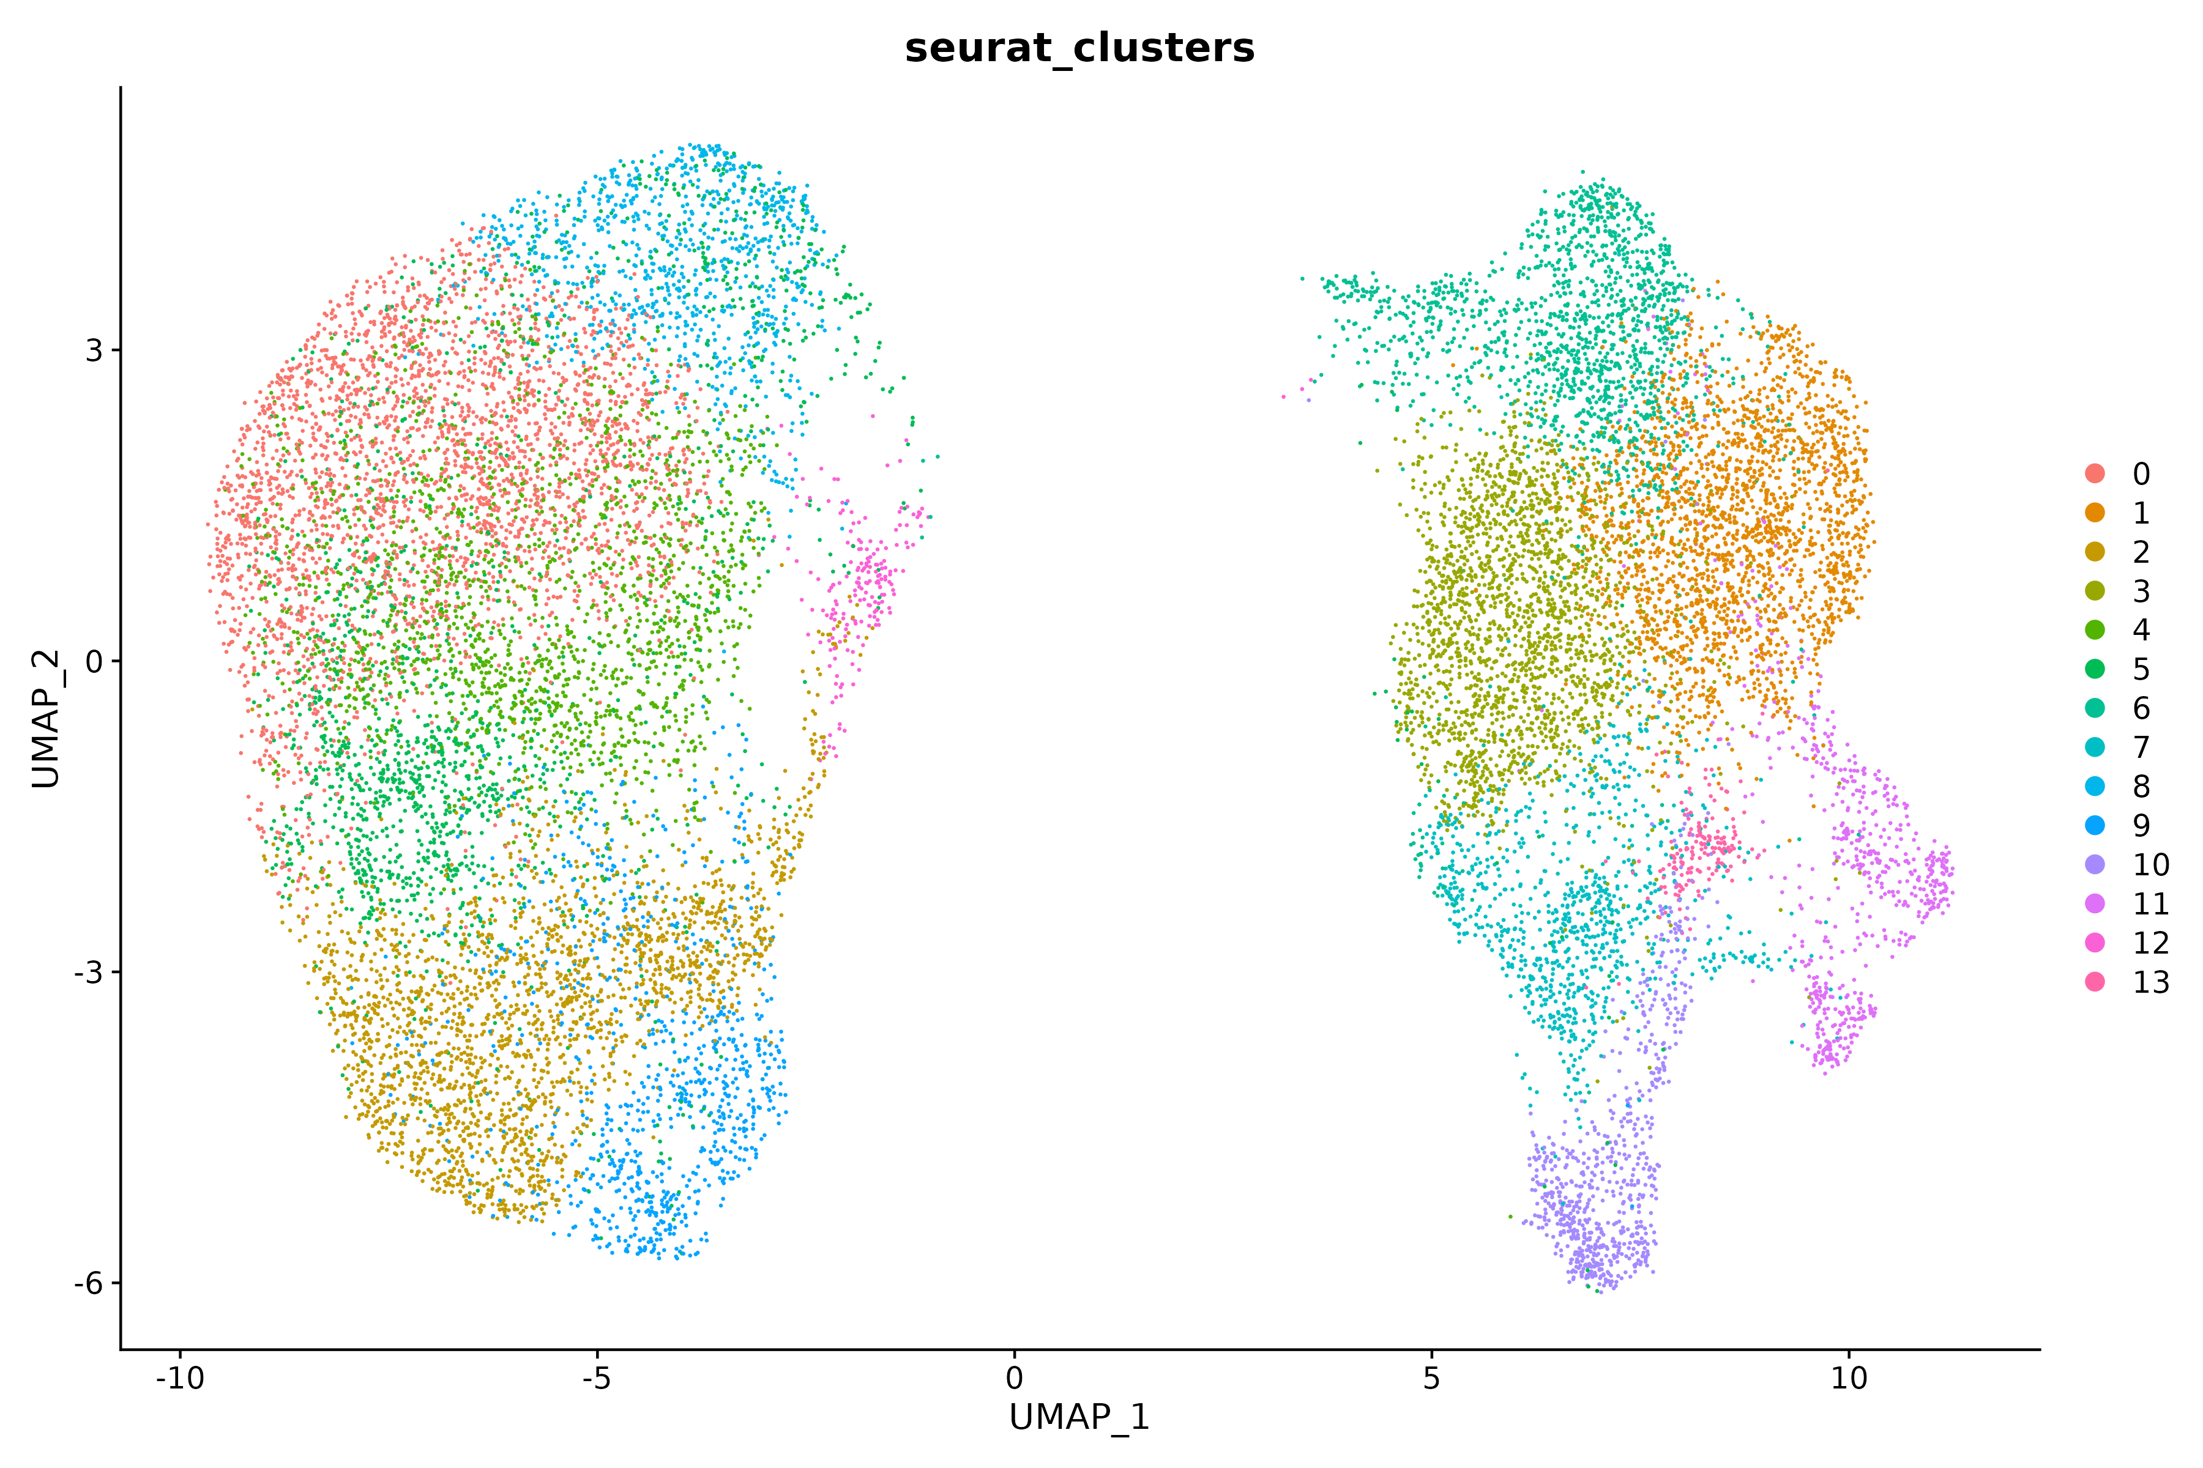
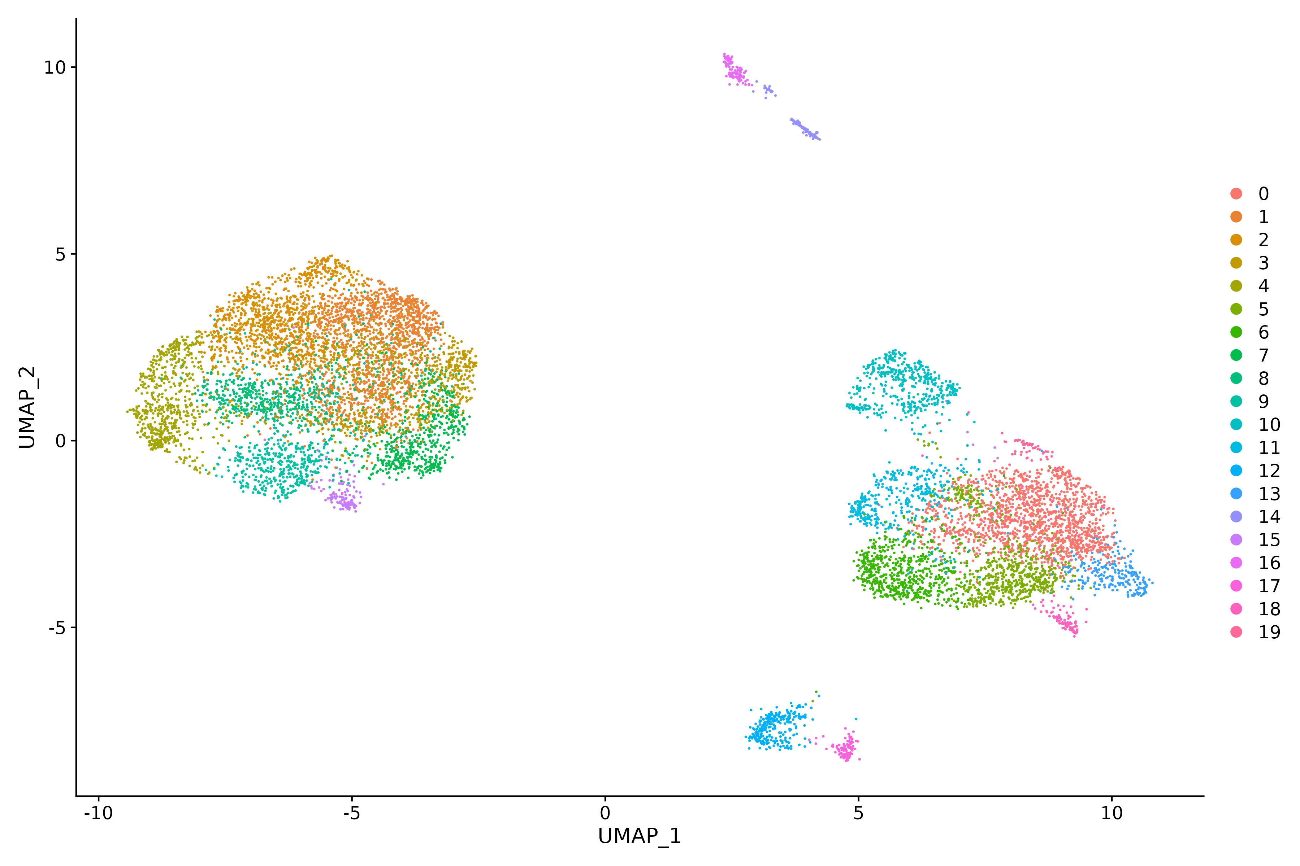
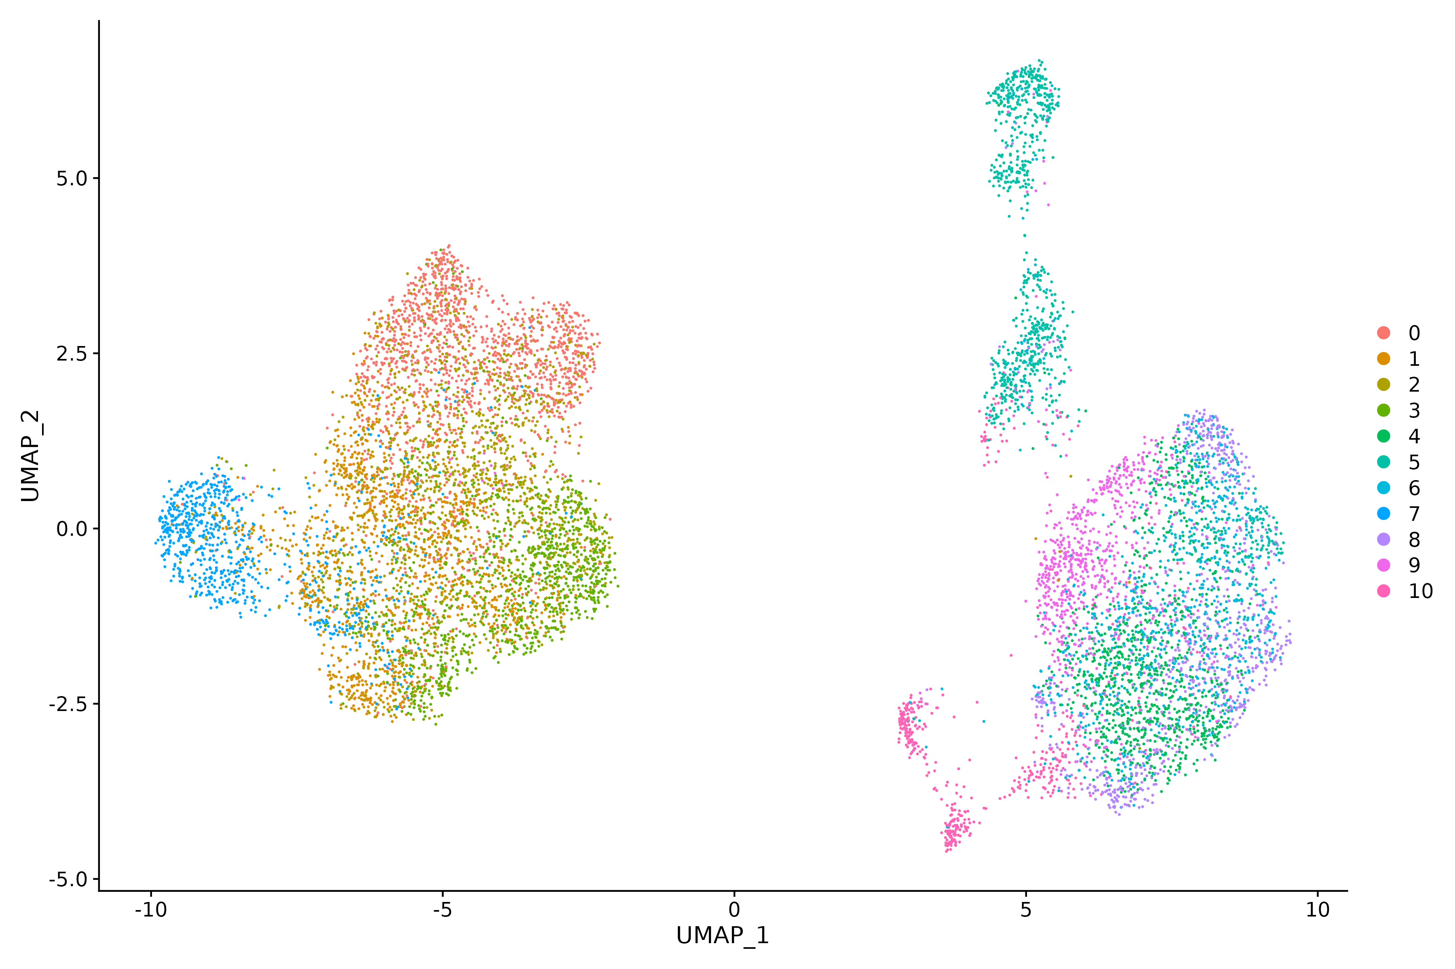
RNA
Multimodal data
ATAC

Slide 4
